Slide 1
Climate Change Project
Ashley Lawler
Victor Lopez
Dernae Rowe
Kamrul Khan

Slide 2
Purpose of the Project
Global warming is the long-term heating of Earth’s climate system observed since the pre-industrial period (between 1850 and 1900) due to human activities, primarily fossil fuel burning, which increases heat-trapping greenhouse gas levels in Earth’s atmosphere. Our analysis of the data will use the correlation between GDP and CO2 emissions to establish a prediction for the impact of climate change on GDP per capita between now and 2100 for a select group of countries.

Slide 3
Description of Source Data
The dataset is a global metric dataset from Jan 1949 to Oct 2018. The dataset includes Country Name, Year, CO2 level, CO2 Growth, Consumption, CO2 from Trade, CO2 Per Capita, % of Global CO2, CO2 from Cement, CO2 from Coal, CO2 from Oil, CO2 from Gas, Population, and Total GDP.
The second dataset uses global temperatures that extend until 2016.

Slide 4
Project Question
The question that we hope to answer with the data is :
How does GDP rates respond to temperature?
Can a country have increase in GDP without increase in CO2 levels?
Which types of CO2 levels respond to an increase in GDP?

Slide 5
Data Exploration & Analysis phase of the Project
Python -- Jupyter Notebook
We have combined the temperature csv with the CO2 emissions/GDP csv dataset. Using PythonData, we have imported the pandas library to delete empty columns and filter the country's column to include only countries that exist (posses a country code and excluding regions and continents). After cleaning the data, we combined the remaining columns and rows into a more concise dataframe. We further analyzed the data to categorize the GDP per capita and CO2 outputs.
SQL Database
We have used a Postgres SQL database hosted by Heroku. Our original file currently contains 24016 rows and 38 columns. We will continue to use Postgres SQL database to process our data as the project progresses.
Machine Learning Model
We are currently using a logistic regression model to make predictions on future emissions outcomes based on the data that includes the variables: temperature, CO2 emissions, population size and GDP. The model is trained using the train_test_split model from the scikit learn library. Thus far, we have measured an accuracy of approximately 99% (result = 0.9945) using the accuracy_score method. We chose a baseline of 300 as a cursory analysis shows that numbers between the max and 300 encapsulate countries with economies known to pollute. Countries with a ratio of co2 to gdp over 300, will be labeled as 'high' and those below 300 will be labeled as 'low’ in the ‘emission_ratio’ column.
Tableau
We have used Tableau to connect to our data sources, extract data into the sources and make visualizations of the data.

Slide 6
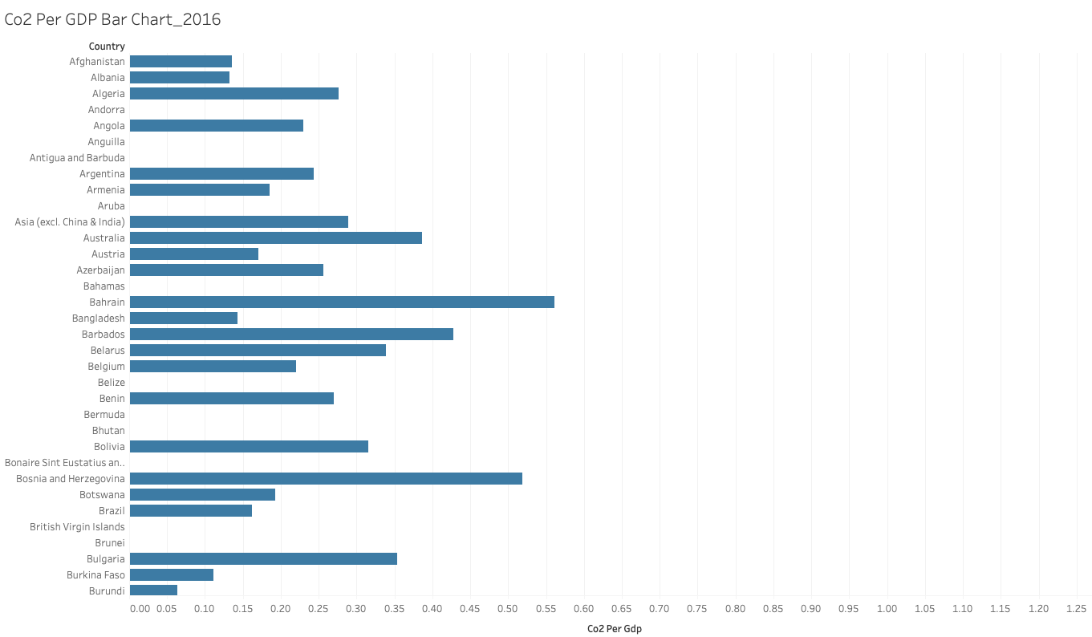
Co2 Per GDP Bar Chart_2016

Slide 7
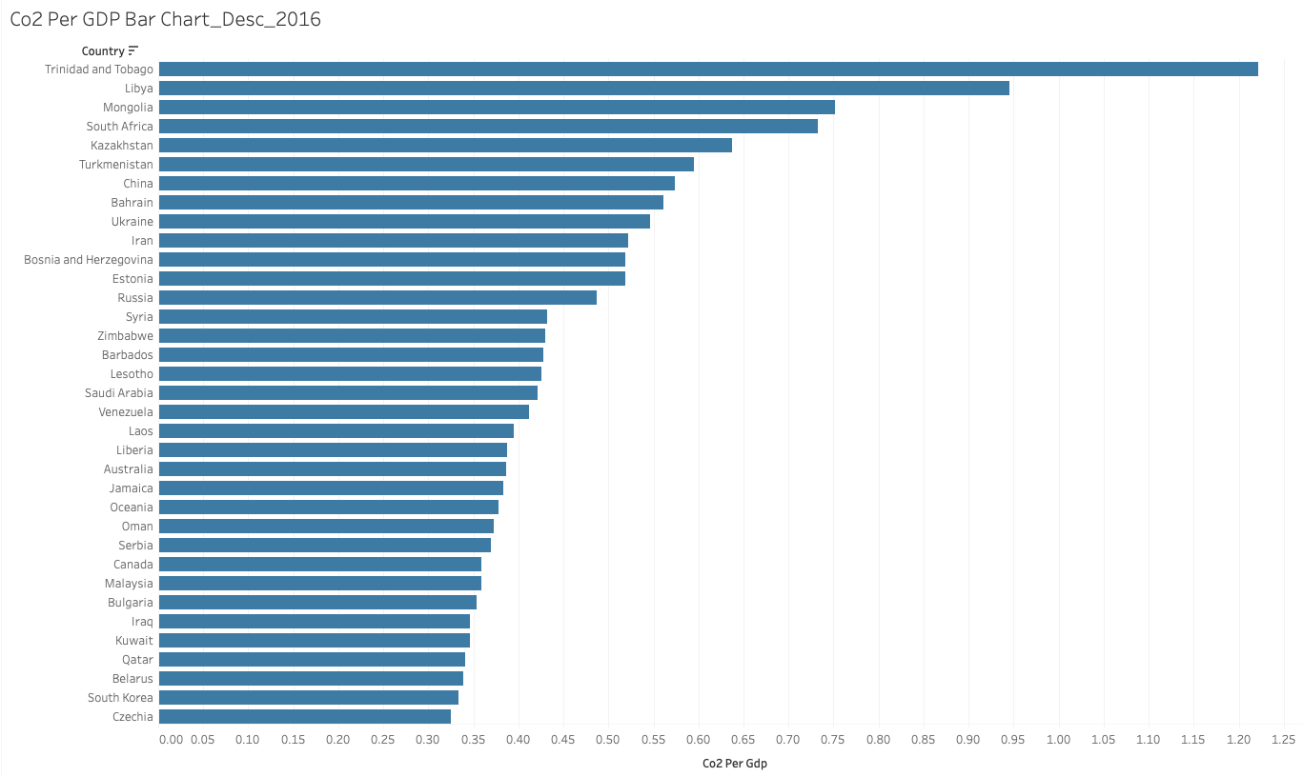
Co2 Per GDP Bar Chart_Desc_2016

Slide 8
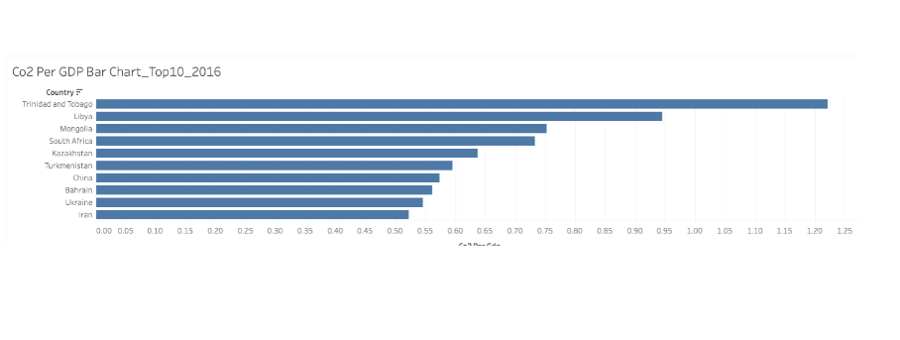
Co2 Per GDP Bar Chart_Top10_2016
CO2 Per GDP

Slide 9
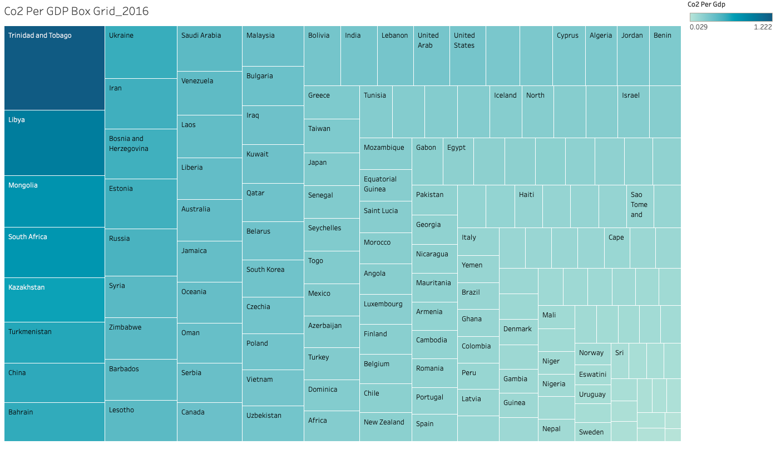
Co2 Per GDP Box Grid_2016

Slide 10
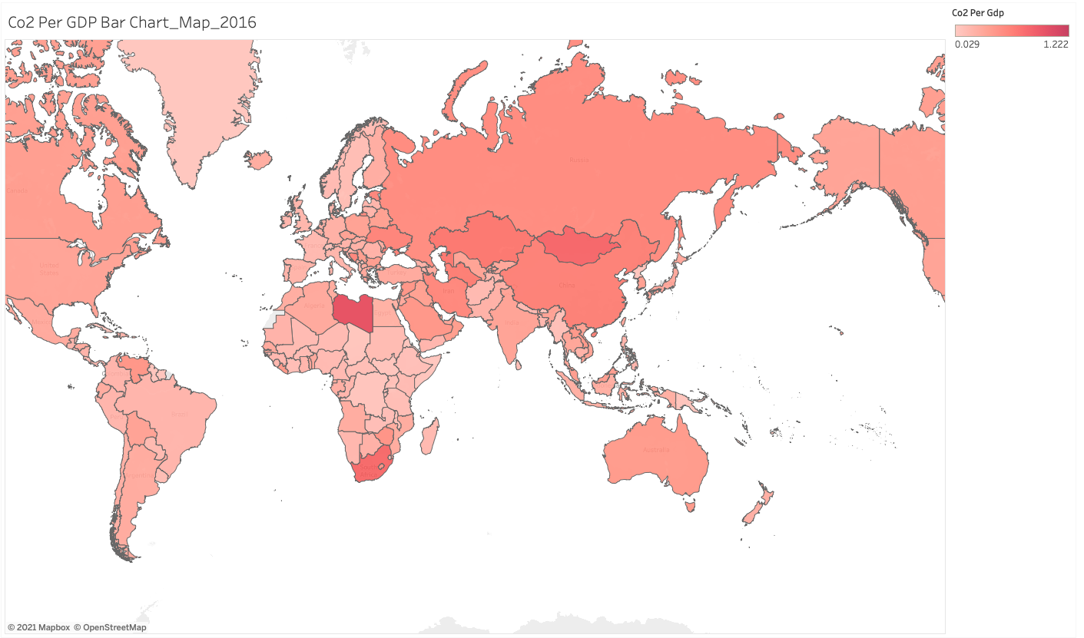
Co2 Per GDP Bar Chart_Map_2016

Slide 11
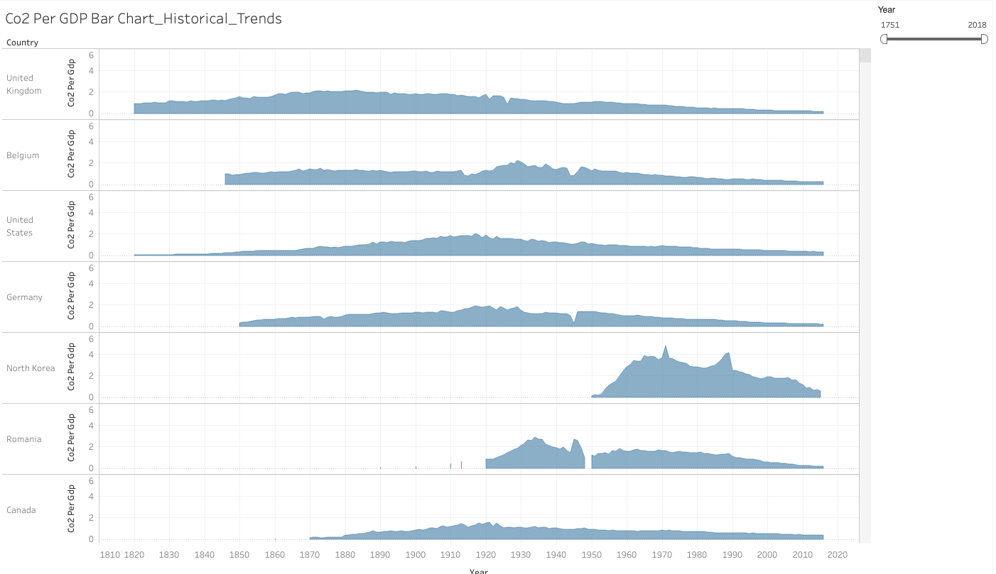
Co2 Per GDP Bar Chart_Historical_Trends

Slide 12
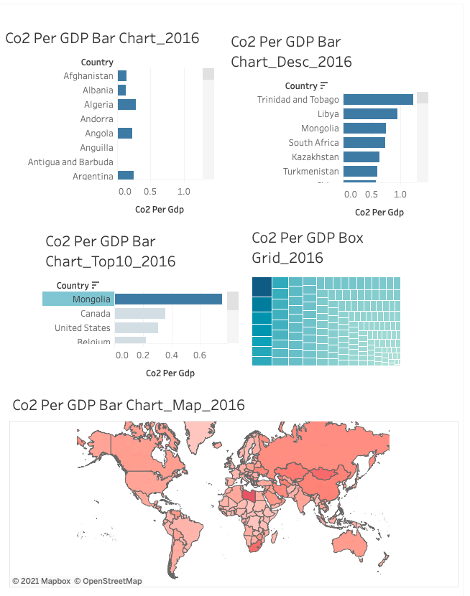
Dashboard

